Slide 1

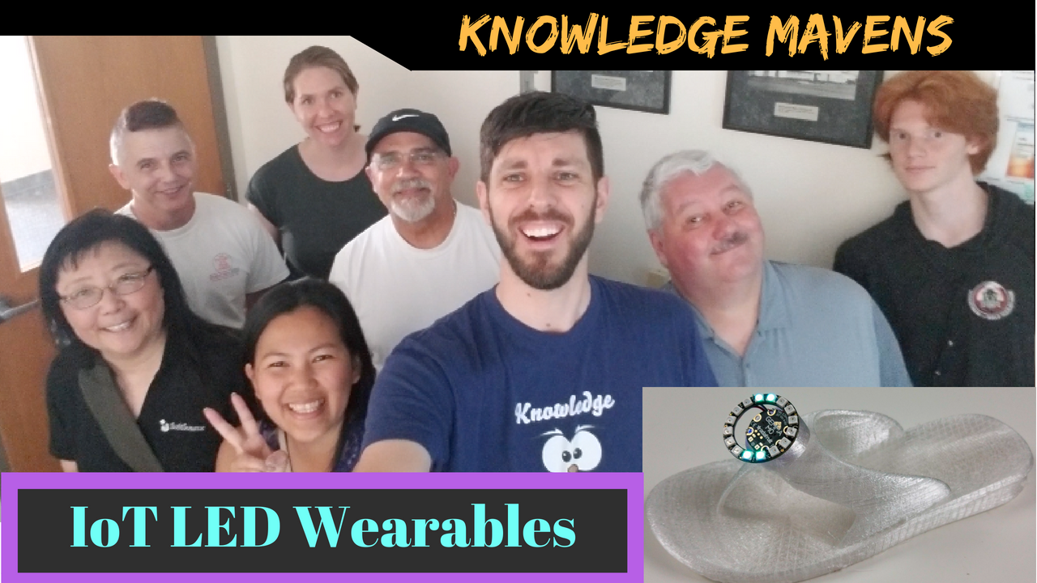




Knowledge Mavens
Who are we and what we do
We’re a group of Scientists, Artist, Engineers, Musicians …aka Polymaths
We “Show and Tell” every Saturday 1pm in Beaverton
Our mission is “Free Knowledge”

Slide 2
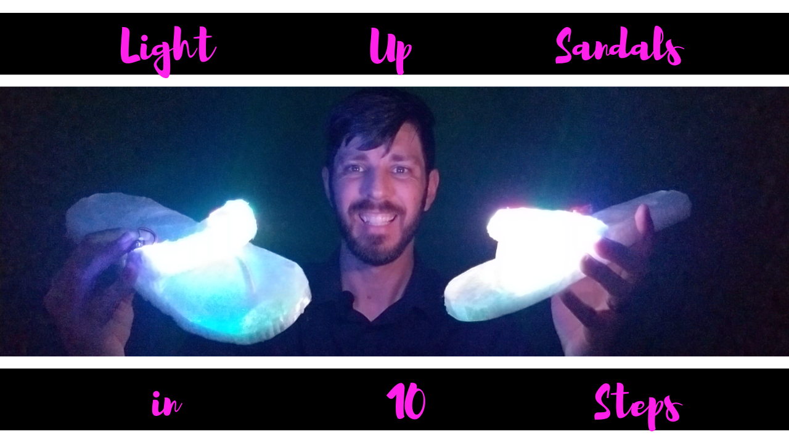

Slide 3
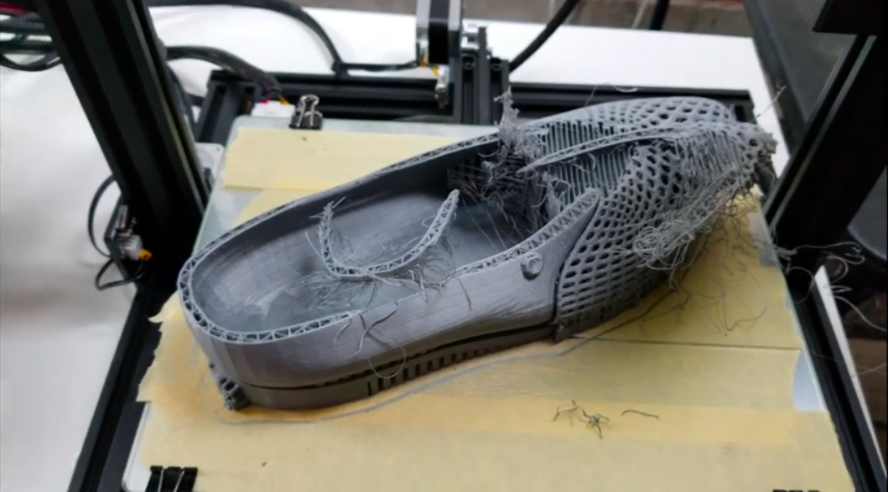
Step 1 - Print a sandal from the internet with PLA filament.

Slide 4
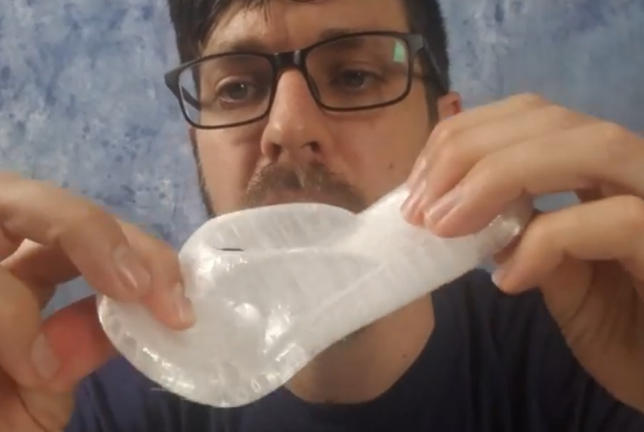
Step 2 - Print a small sandal from the internet with flex filament

Slide 5
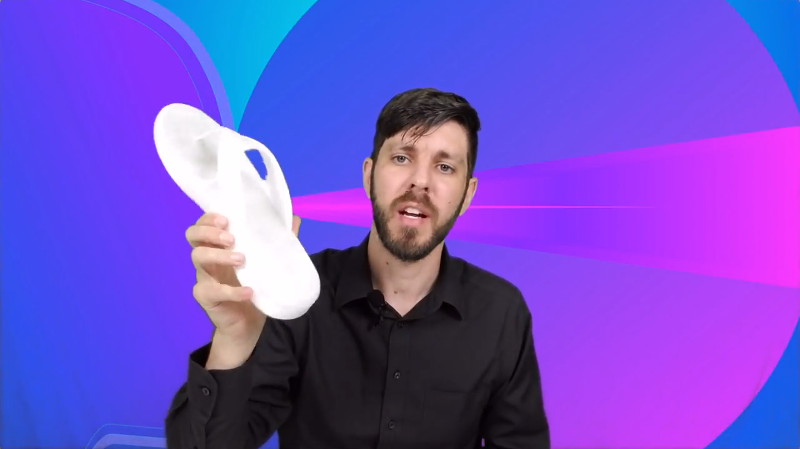
Step 3 - Print large shoe from the internet with flex filament

Slide 6
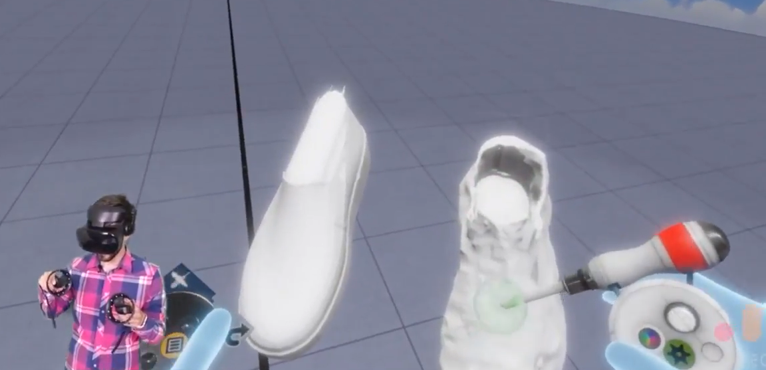
Step 4 - Test designing by referencing a Mesh in Oculus Medium

Slide 7
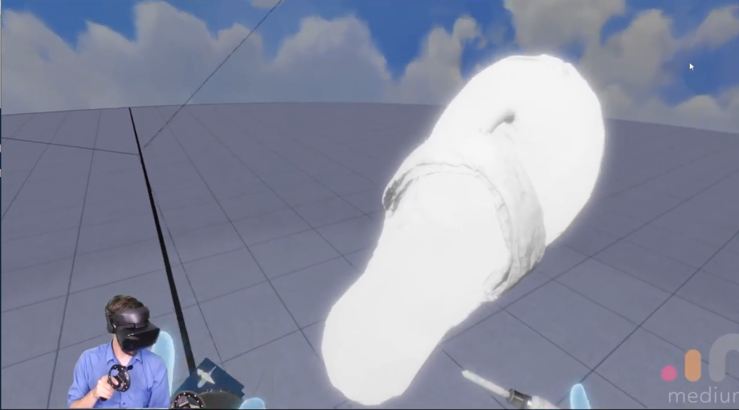
Step 5 - Create a new design without a template in Oculus Medium

Slide 8
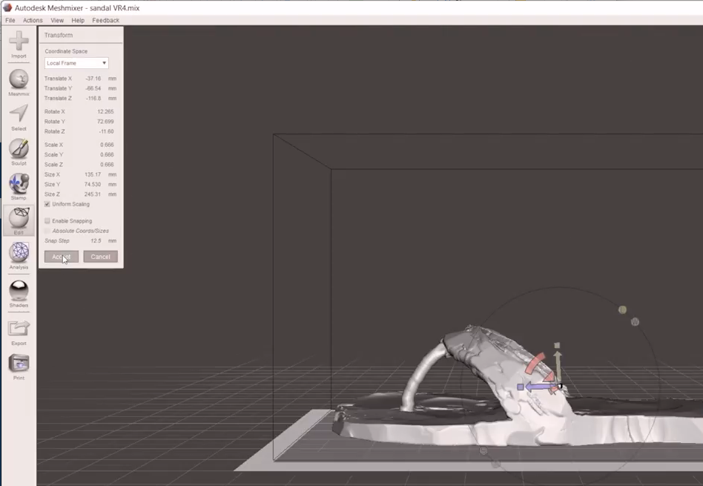
Step 6 - Transform with Autodesk Meshmixer

Slide 9
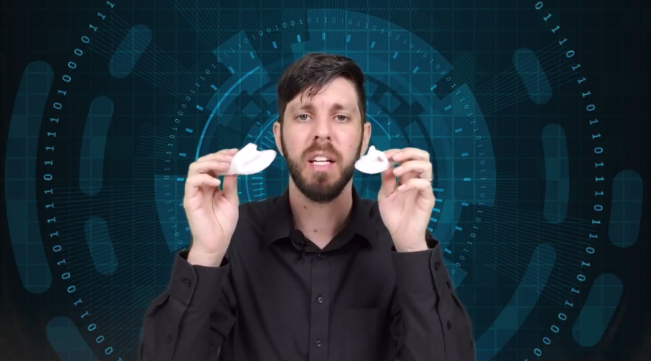
Step 7 - Test printing small design

Slide 10
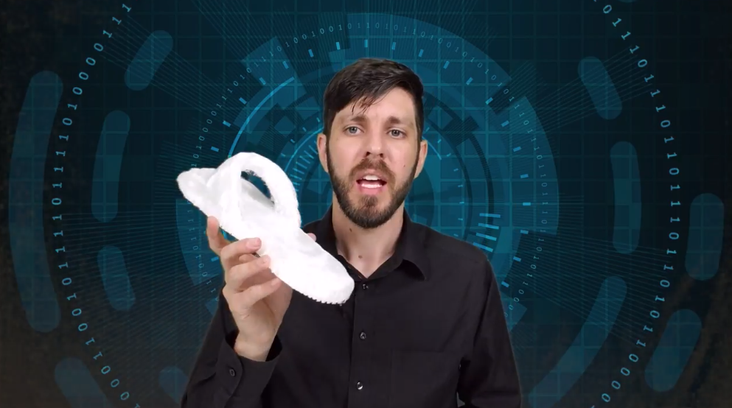
Step 8 - Make modifications and print large design (Iterate as necessary)

Slide 11
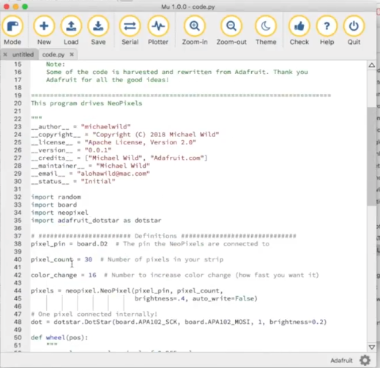
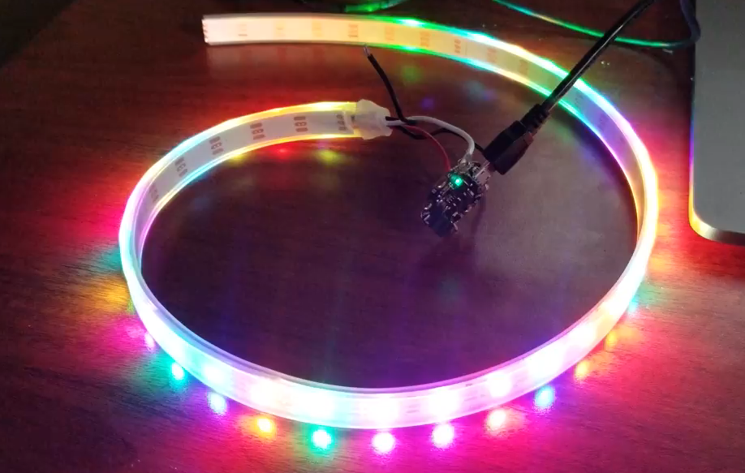
Step 9 - Code Gemma with Mu-Editor and test connections of Neopixel strip.

Slide 12
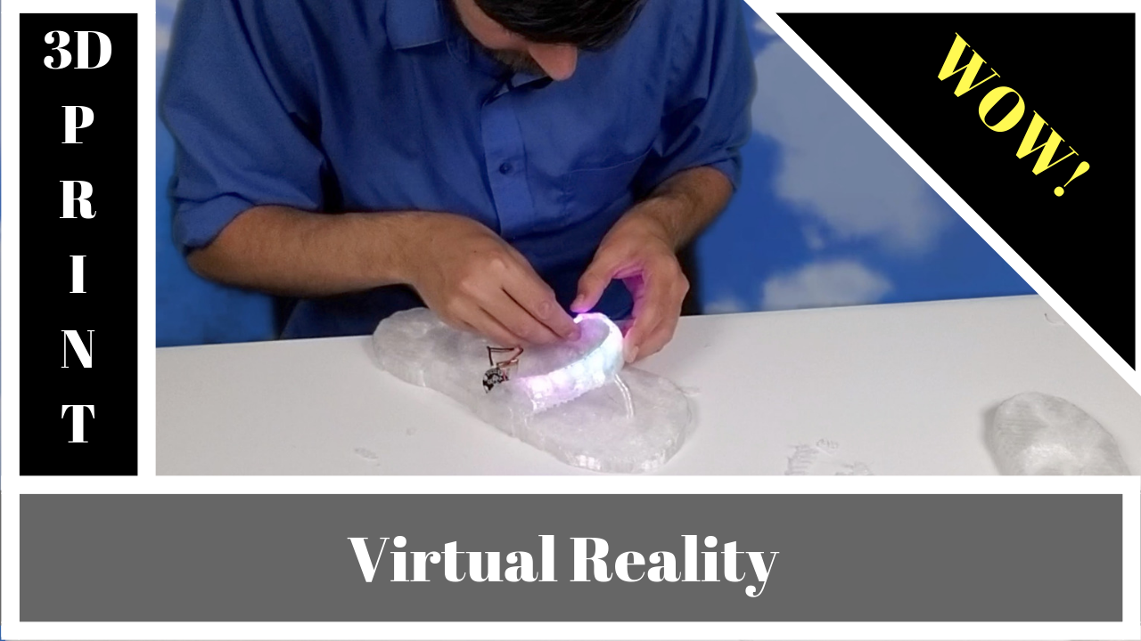
Step 10 - Solder Neopixel strip to Gemma and insert in Sandal

